Slide 1
Final Draft as of 10.25
File created on: 10/26/20 3:49:58 PM EDT

Slide 2
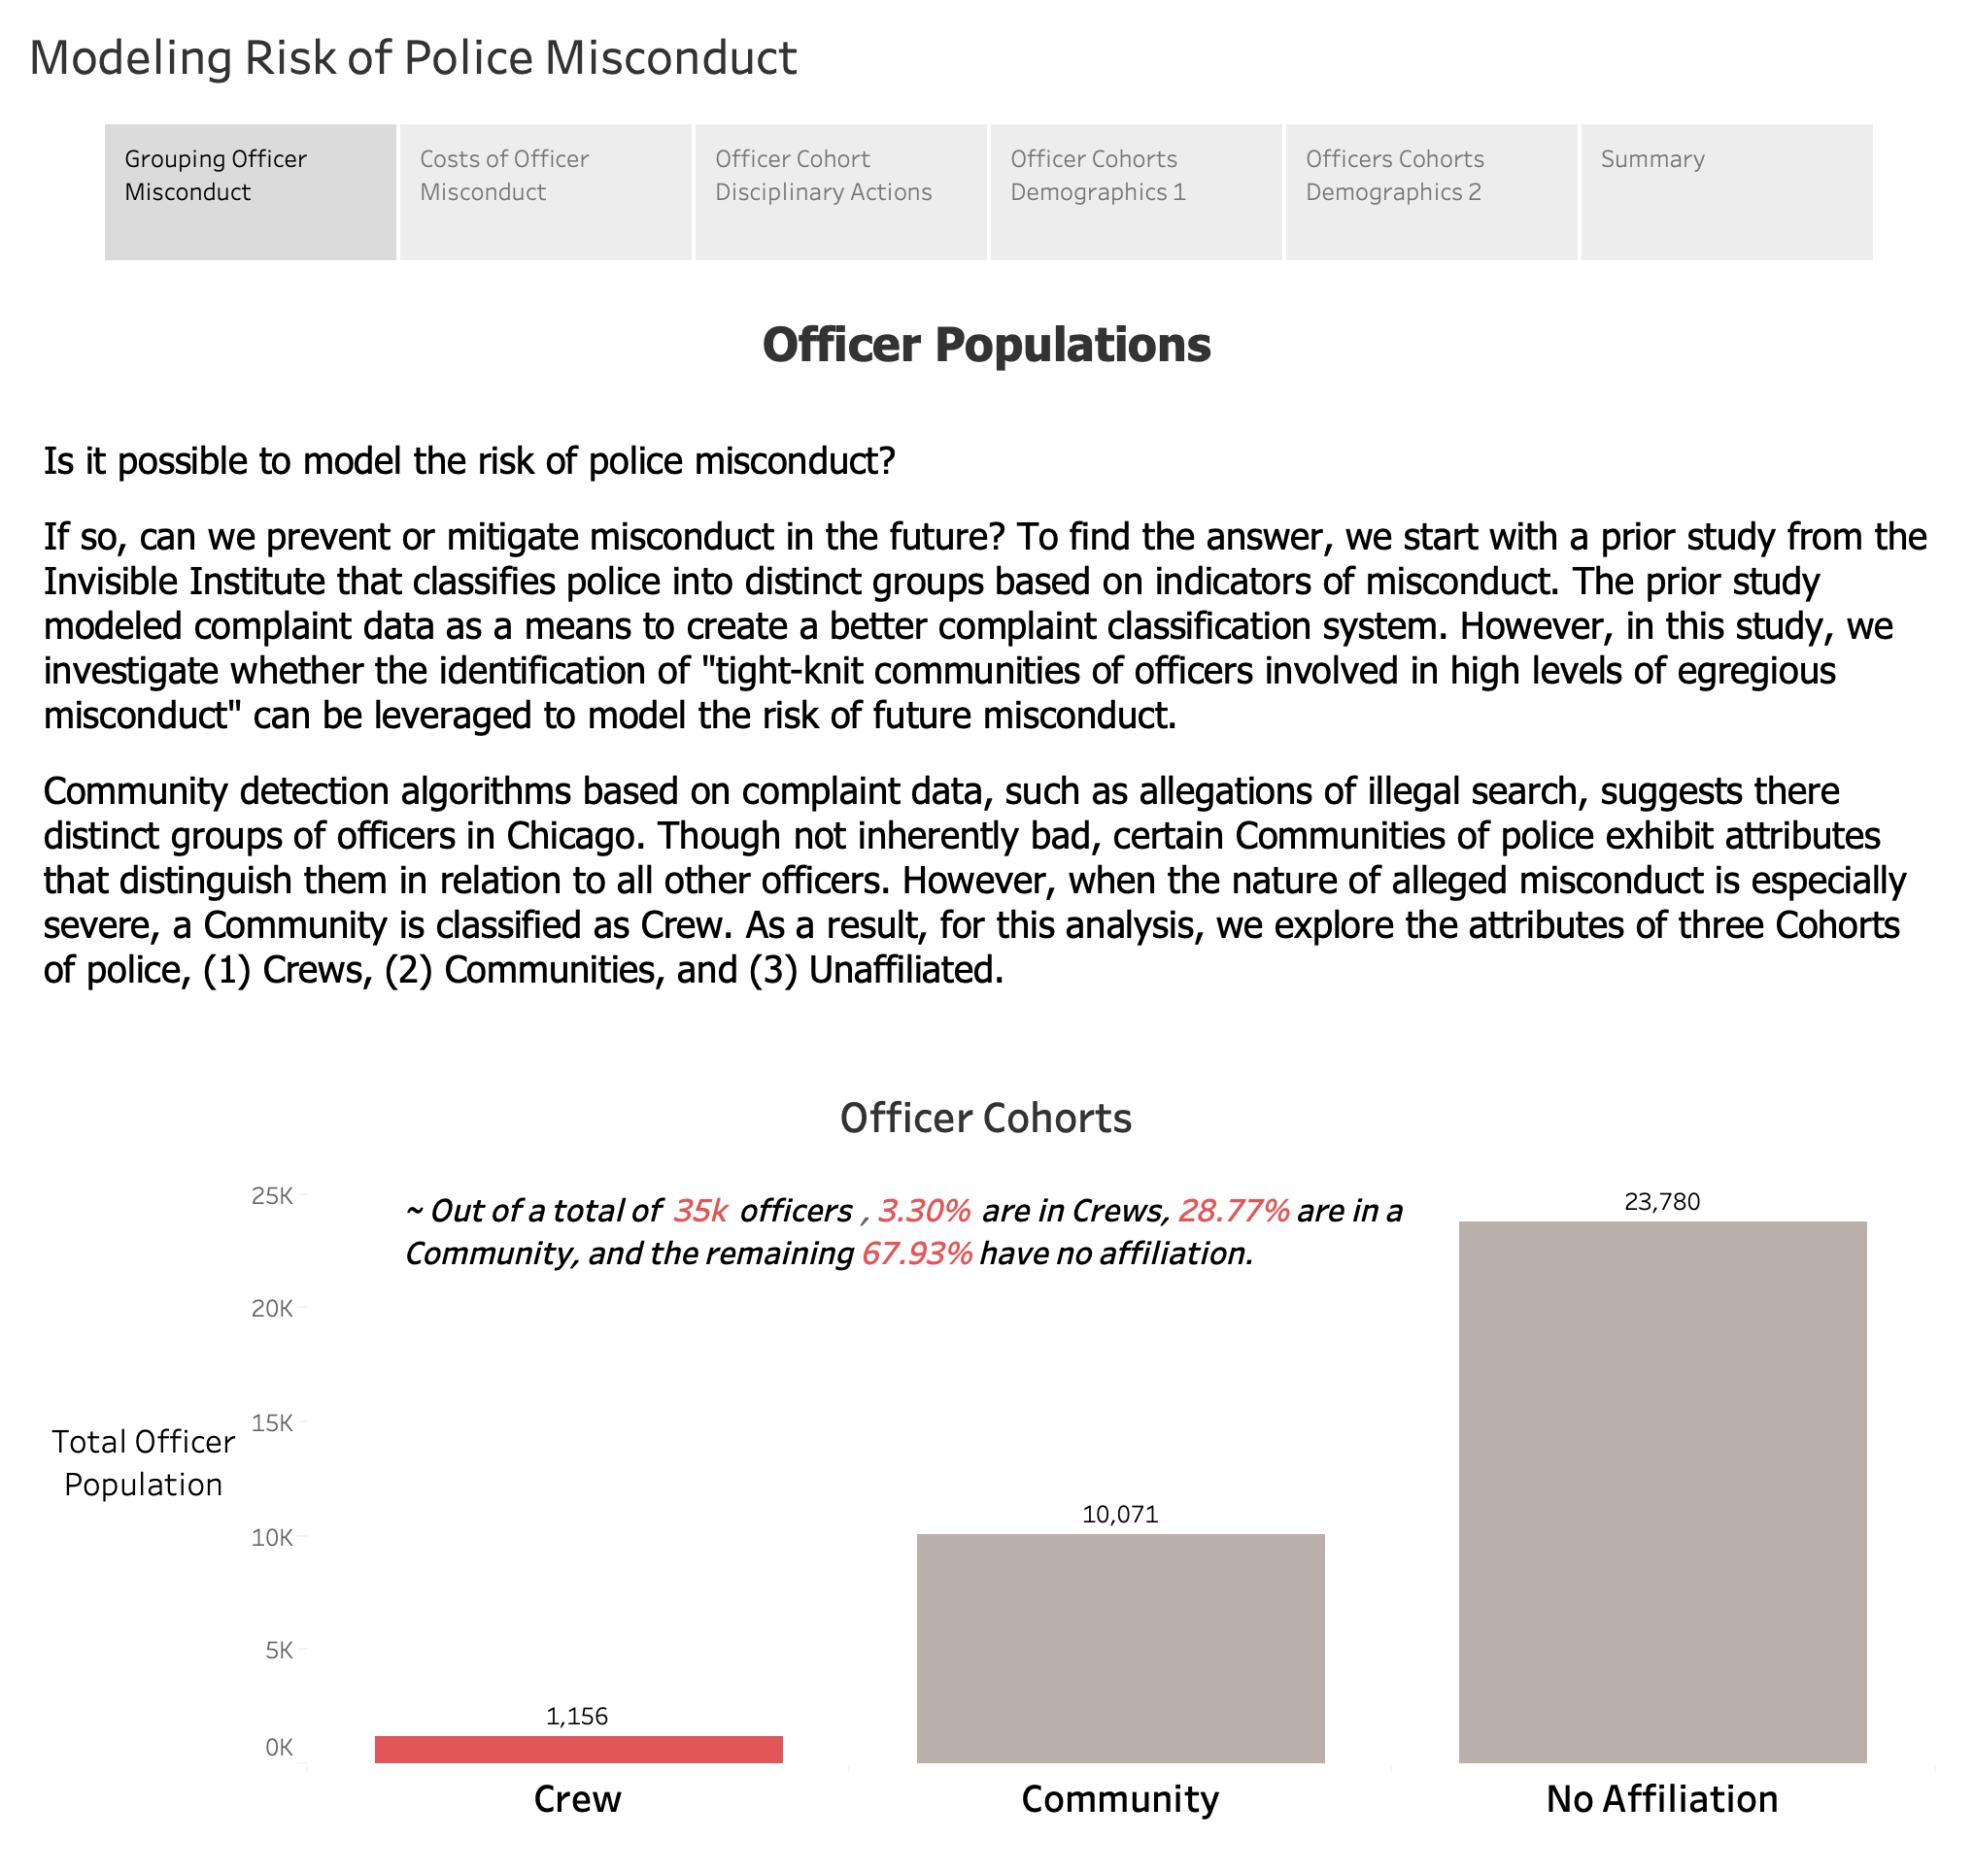

Slide 3
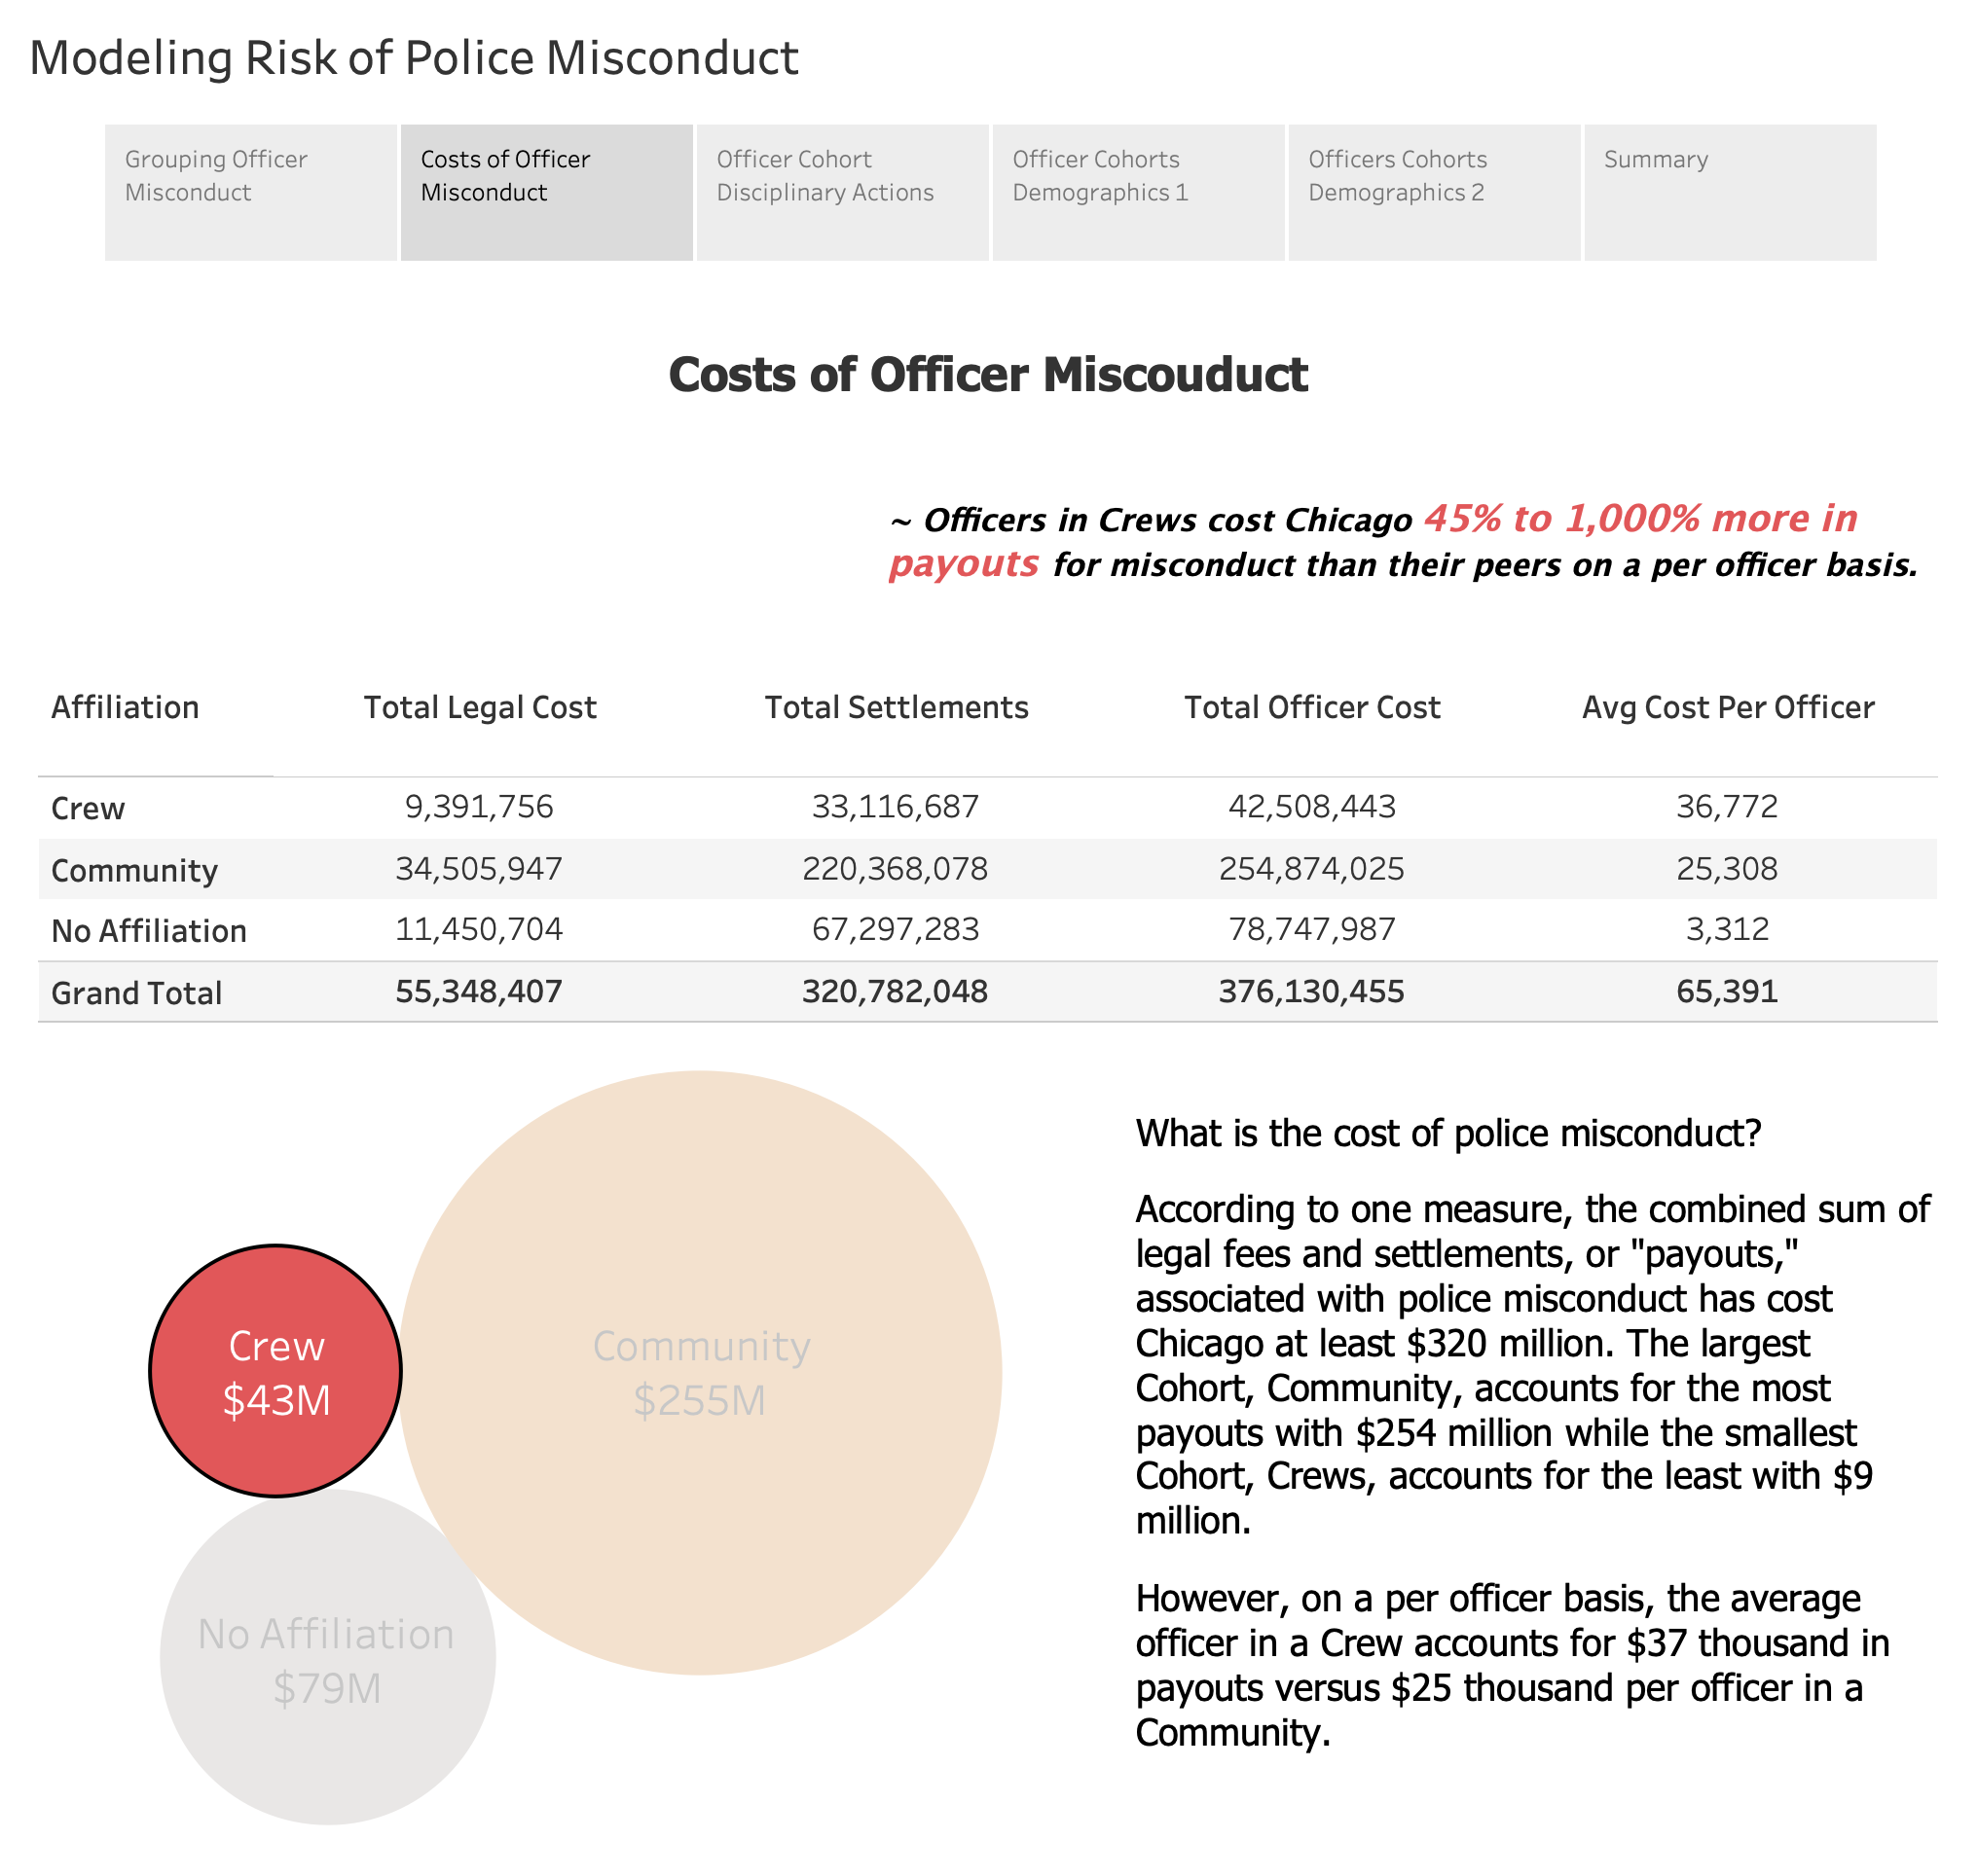

Slide 4
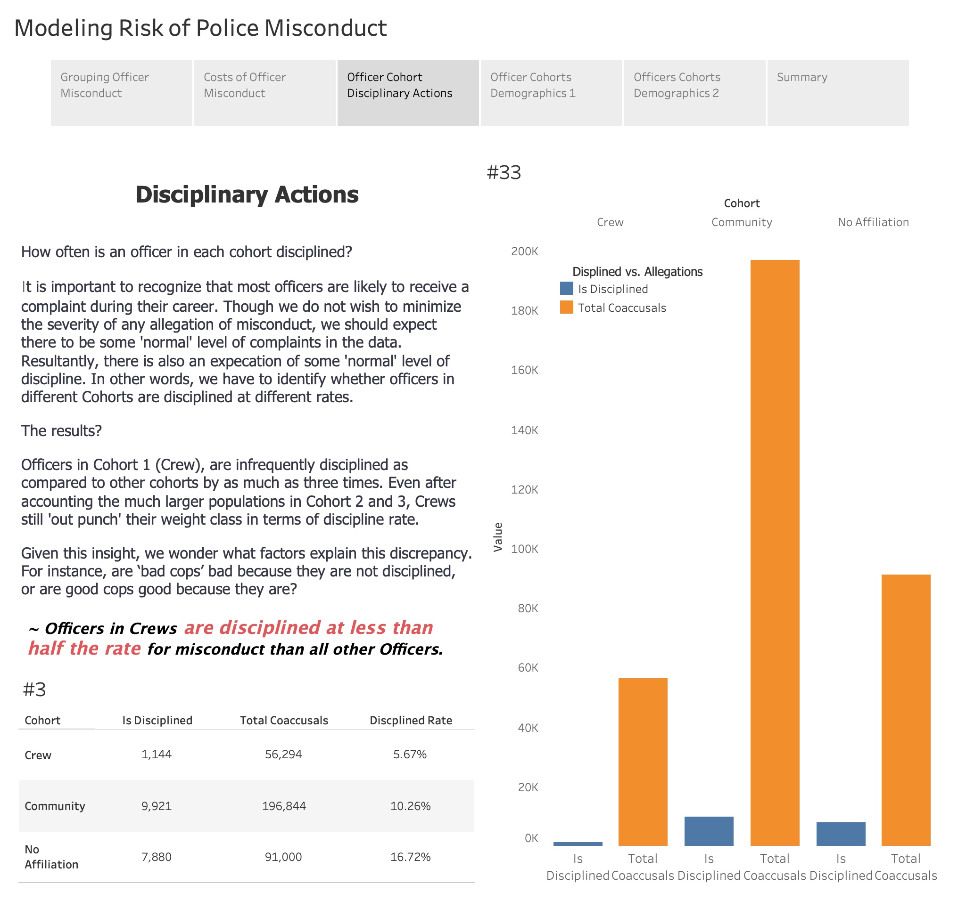

Slide 5
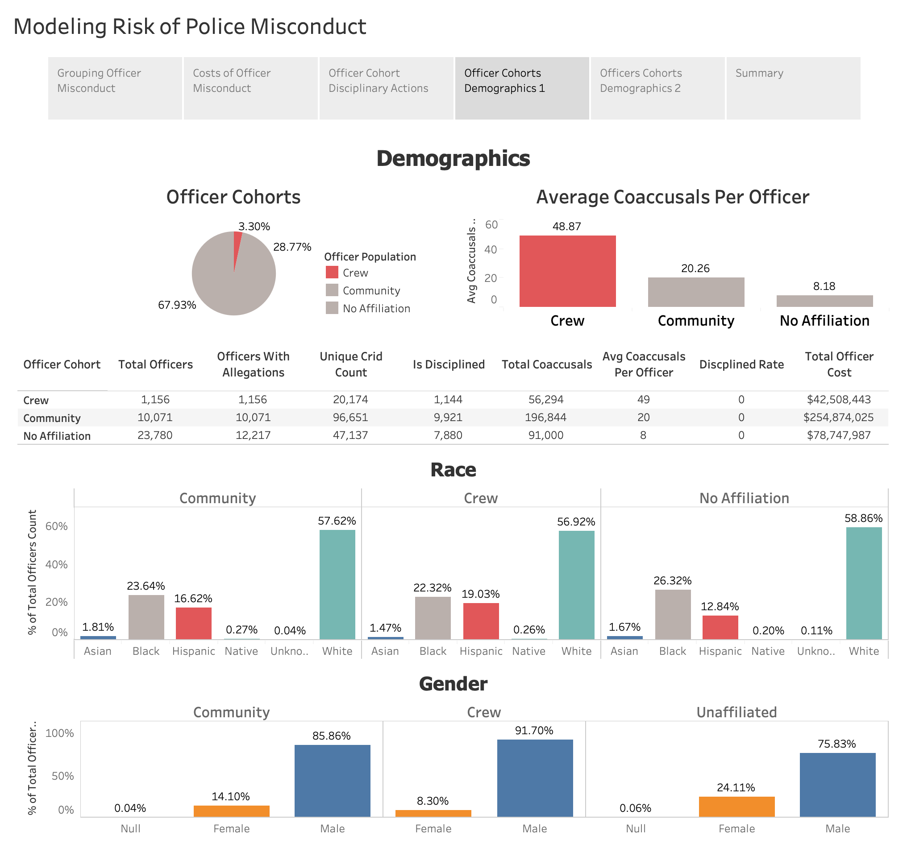

Slide 6
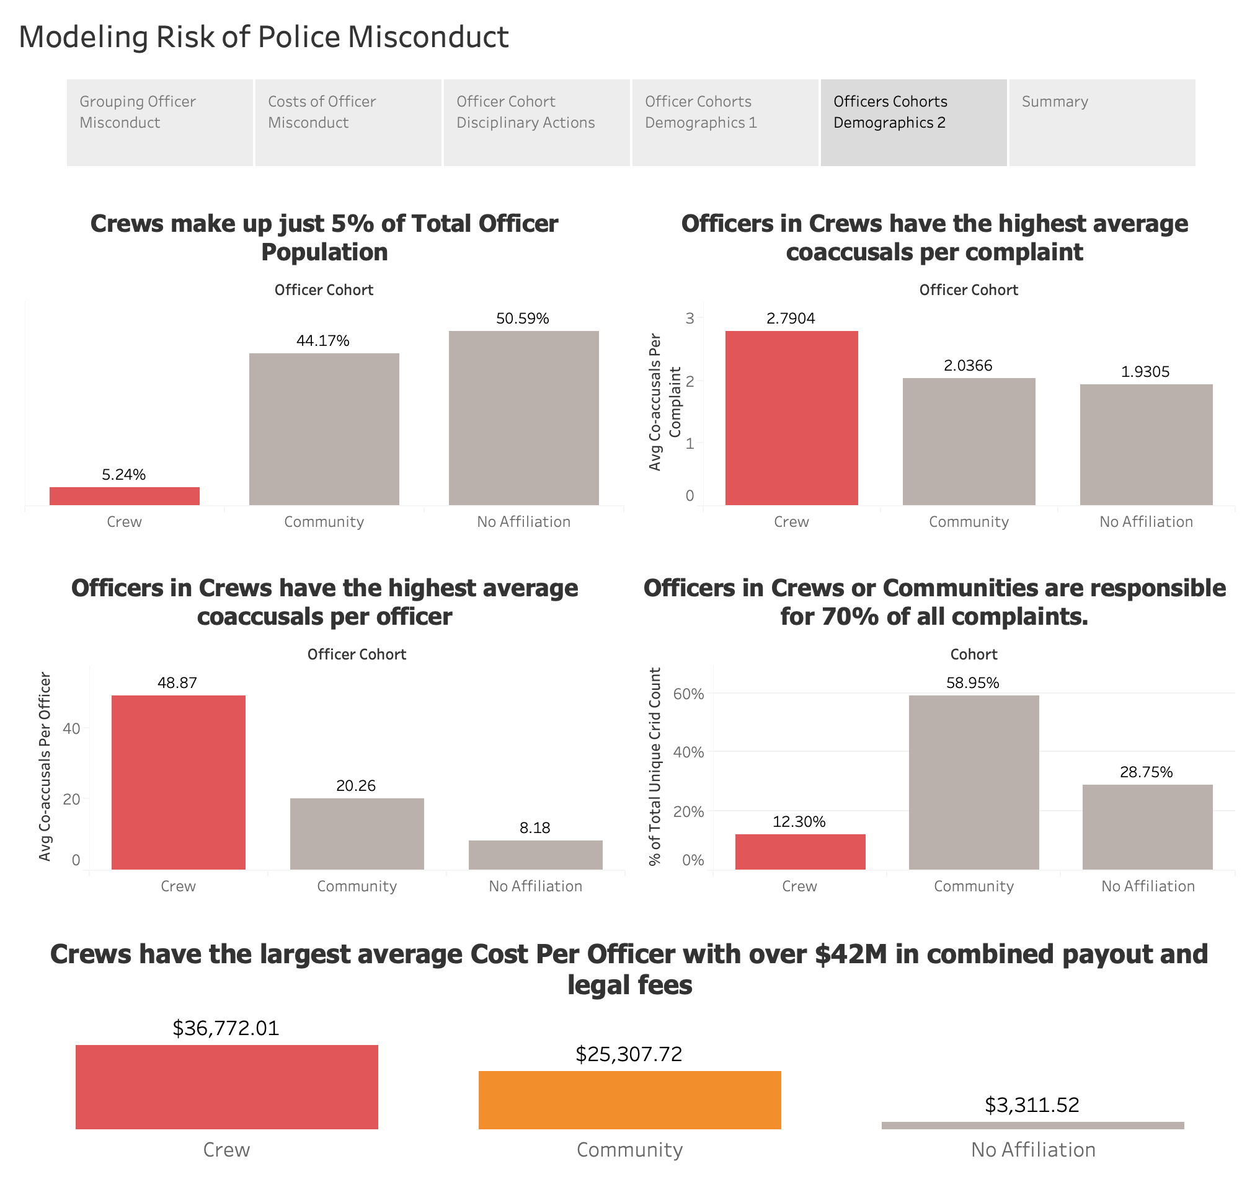

Slide 7
